Slide 1


Slide 2
[01] Introduction to ATLAS
[02] Phenotyping
[03]
Cohort building
[04] Cohort Characterisation
[05] Cohort Pathways
[06]
Incidence Rates
[07] ATLAS Administration
Index

Slide 3
[01]
Introduction to ATLAS

Slide 4
[01.1]
Presentation and Access

Slide 5
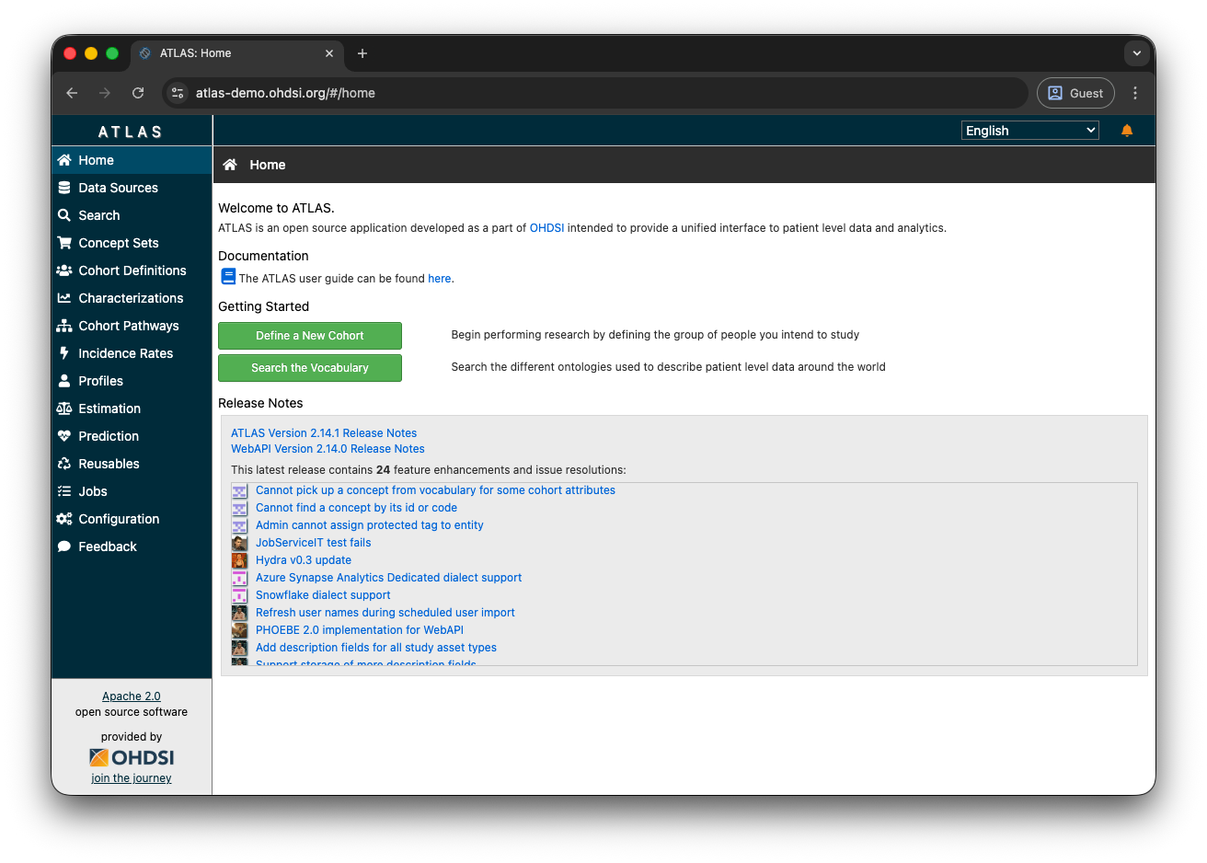
[01] Introduction to ATLAS
ATLAS is an intuitive web-based tool developed by OHDSI.
ATLAS provides the tools needed to perform real-time analyses using patient-level observational data.

Slide 6



[01] Introduction to ATLAS
ATLAS is an intuitive web-based tool developed by OHDSI.
ATLAS connects to one or more instances of the OMOP CDM to query the data.
Through ATLAS, aggregated data can be queried.
Database OMOP CDM

Slide 7
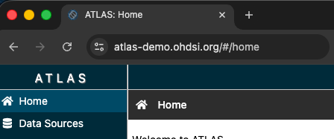
[01] Introduction to ATLAS
Public OHDSI ATLAS instance for training purposes.
OHDSI has made an ATLAS instance publicly available online for demos, training, and practice.
This instance comes with preloaded data for testing.
https://atlas-demo.ohdsi.org

Slide 8
[01.2]
Data Sources

Slide 9
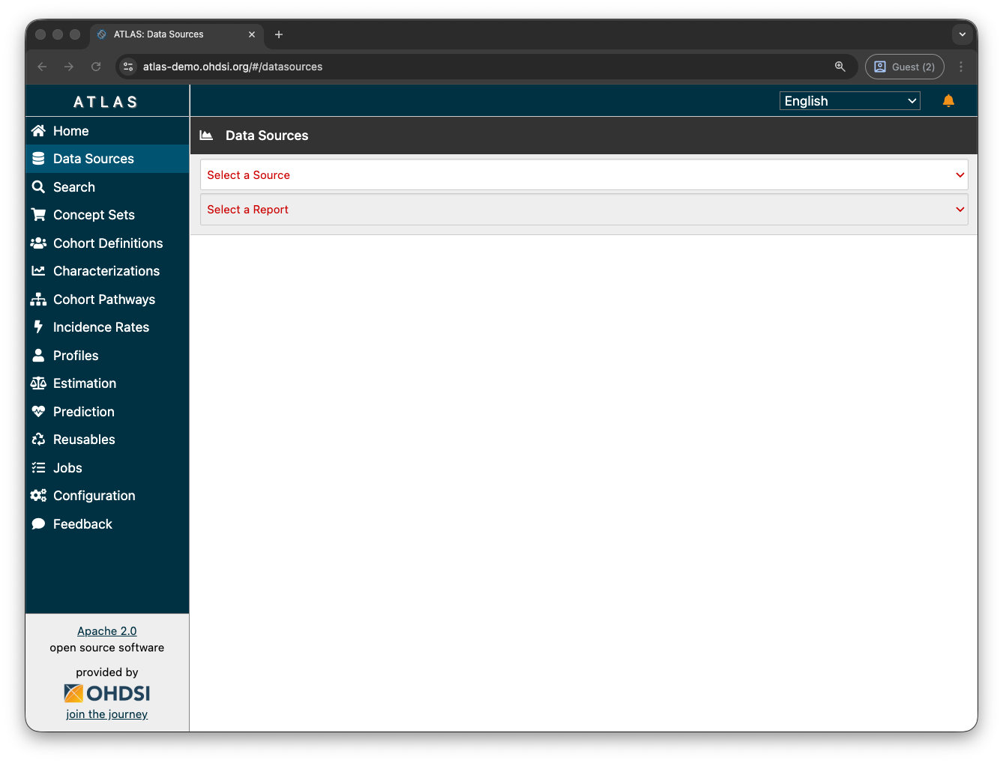
[01] Introduction to ATLAS
Overview of data sources through the Data Sources functionality.
Accessible through the “Data Sources” menu item.

Slide 10
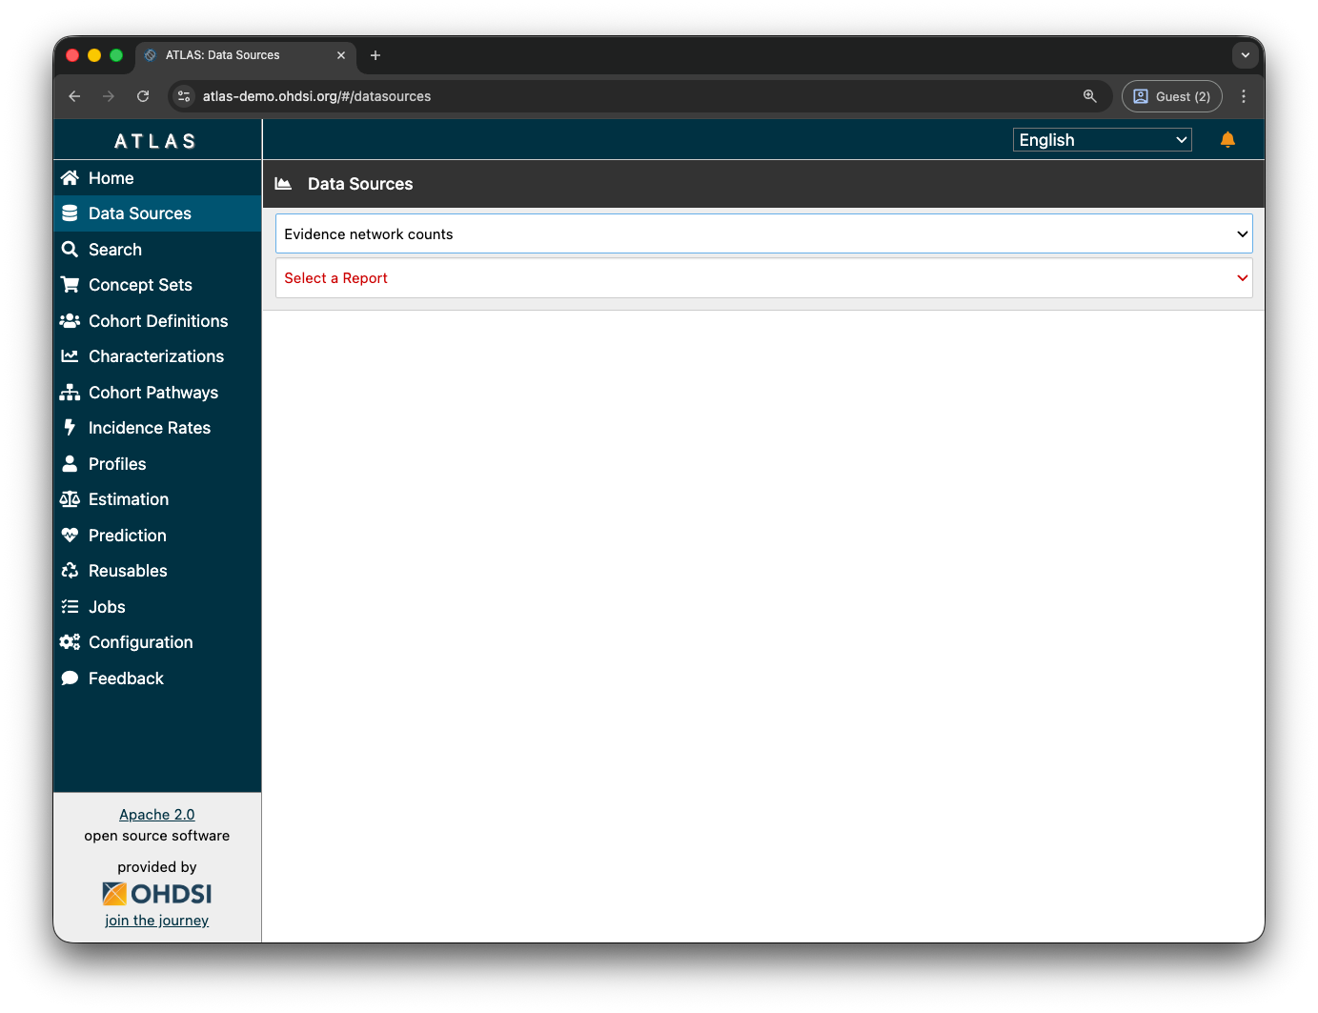
[01] Introduction to ATLAS
Overview of data sources through the Data Sources functionality.
The available data sources appear in the dropdown menu.

Slide 11
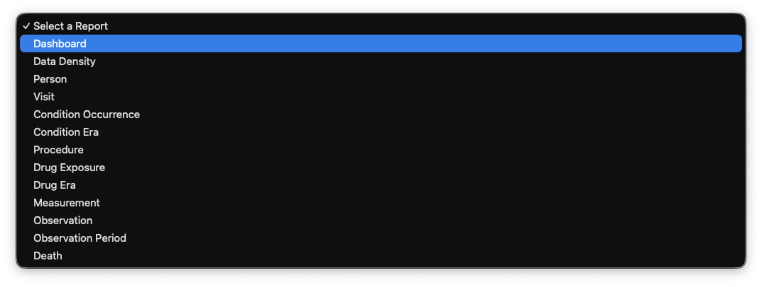
[01] Introduction to ATLAS
Overview of data sources through the Data Sources functionality.
The different available reports provide an overview of various characteristics of the data sources.

Slide 12
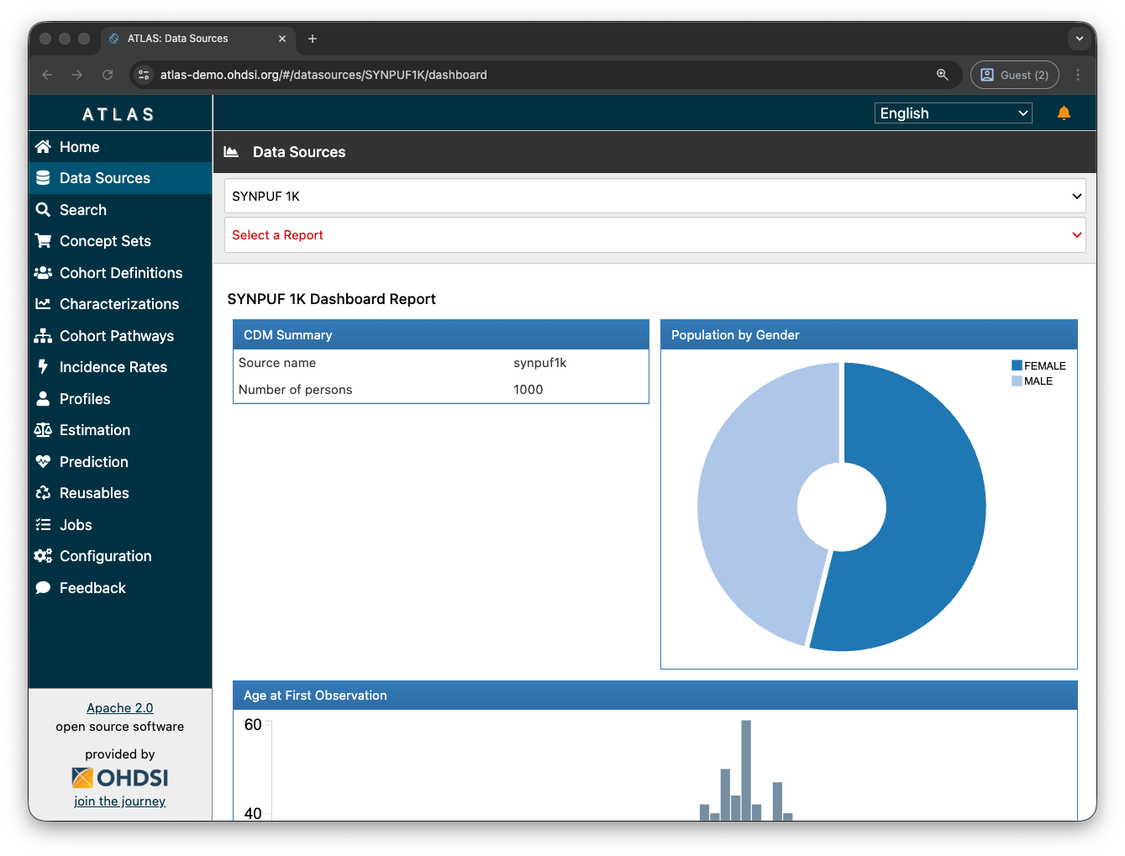
[01] Introduction to ATLAS
Overview of data sources through the Data Sources functionality.
The dashboard report provides an overview of the total number of patients in the data source, along with other stratifications (gender, age, etc.).

Slide 13
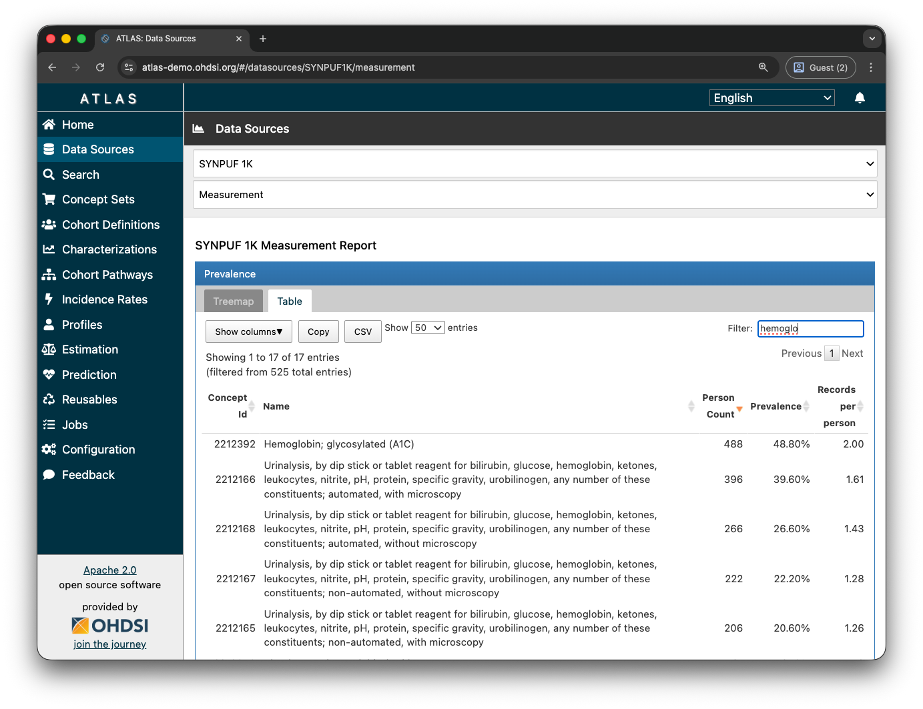
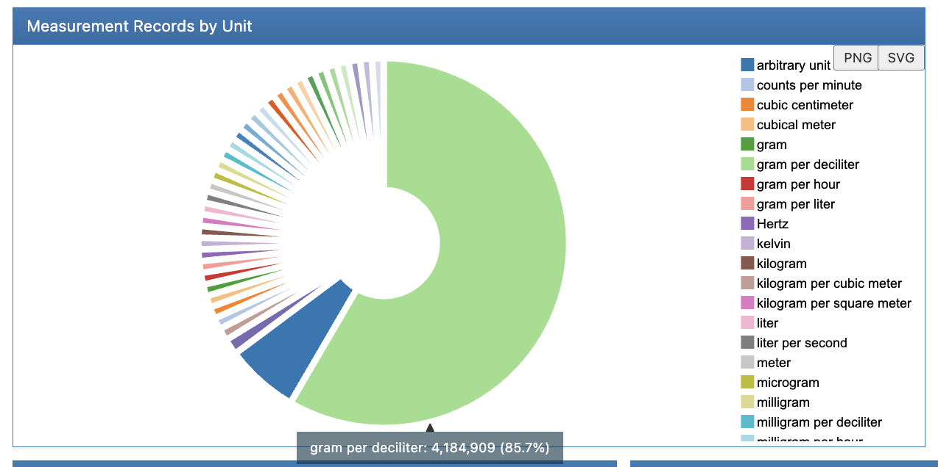
[01] Introduction to ATLAS
Overview of data sources through the Data Sources functionality.
The Measurement report provides an aggregated view of concepts in the Measurement domain. It highlights the available units for each concept.

Slide 14
[01] Introduction to ATLAS
Exercise 1: Records per person.
Find the average number of records per person in the Conditions domain in October 2008 for the SYNPUF 1k data source.

Slide 15
[01] Introduction to ATLAS
Exercise 1: Records per person.
Find the average number of records per person in the Conditions domain in October 2008 for the SYNPUF 1k data source.
Answer: 5532

Slide 16
[01] Introduction to ATLAS
Exercise 2: Total visits in OMOP by type.
Find the total number of visits by type in the SYNPUF 1k data source.

Slide 17
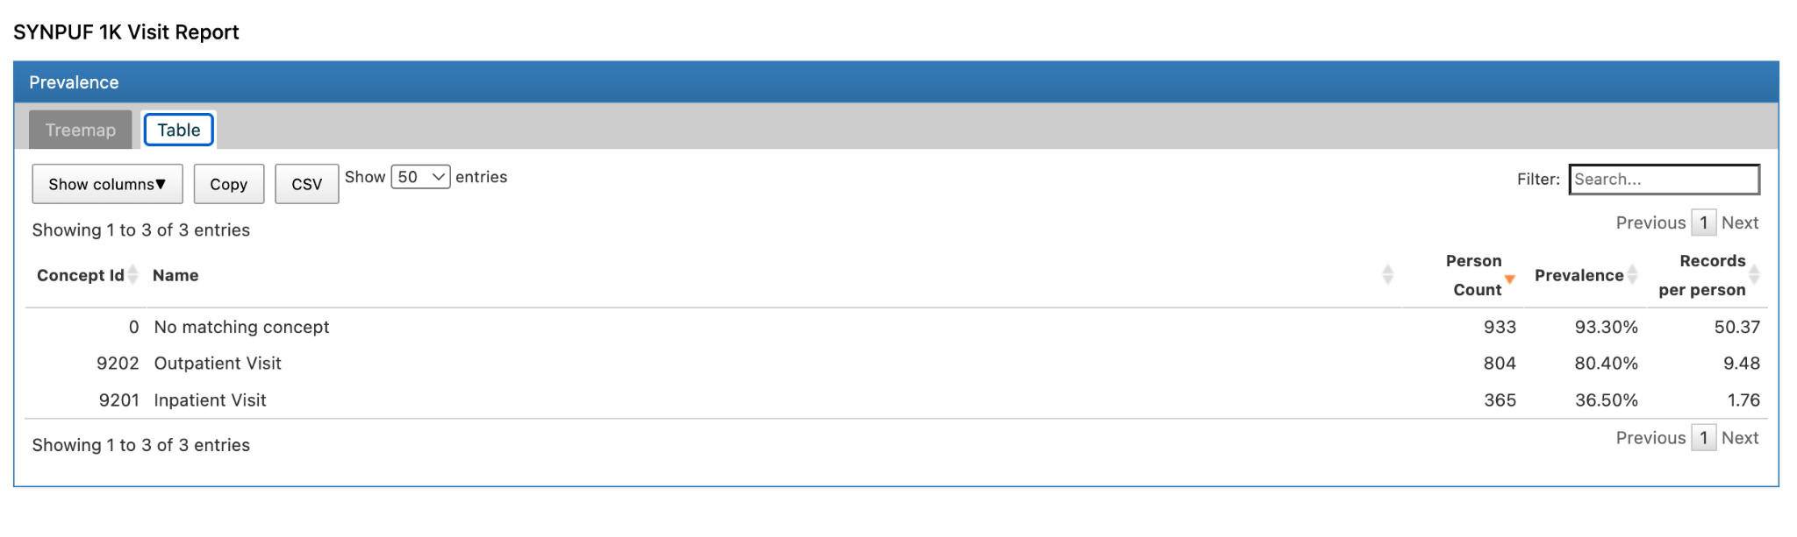
[01] Introduction to ATLAS
Exercise 2: Total visits in OMOP by type.
Find the total number of visits by type in the SYNPUF 1k data source.

Slide 18
[01] Introduction to ATLAS
Exercise 3: Total number of patients with type 1 diabetes mellitus.
Find the total number of patients with type 1 diabetes in the SYNPUF 1k data source.

Slide 19
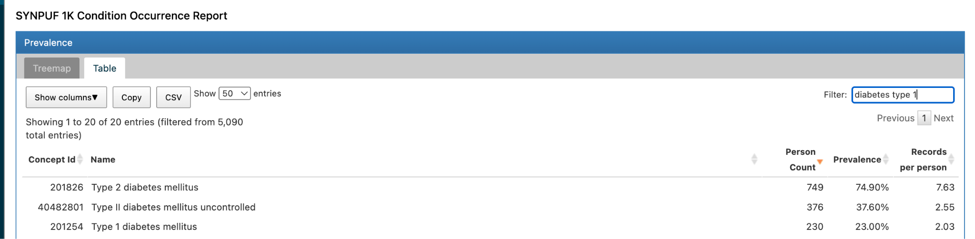
[01] Introduction to ATLAS
Exercise 3: Total number of patients with type 1 diabetes mellitus.
Find the total number of patients with type 1 diabetes in the SYNPUF 1k data source.

Slide 20
[01] Introduction to ATLAS
Exercise 4: Find the different units for glycated hemoglobin.
SYNPUF 1k data source.

Slide 21
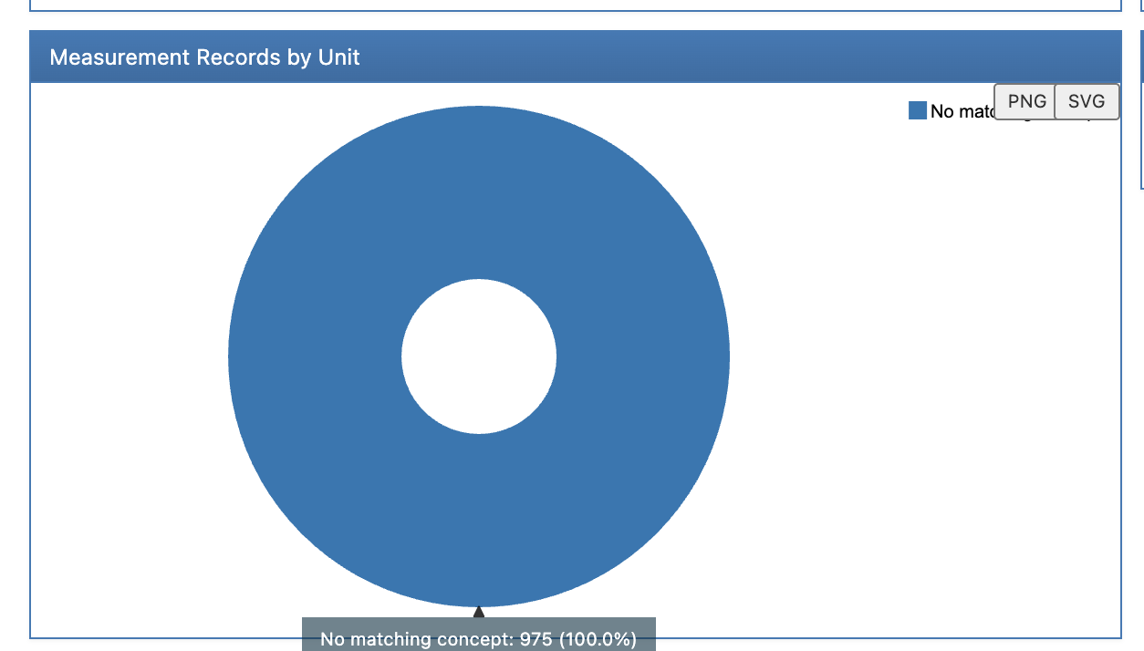
[01] Introduction to ATLAS
Exercise 4: Find the different units for glycated hemoglobin.
SYNPUF 1k data source.

Slide 22
[02]
Phenotyping

Slide 23
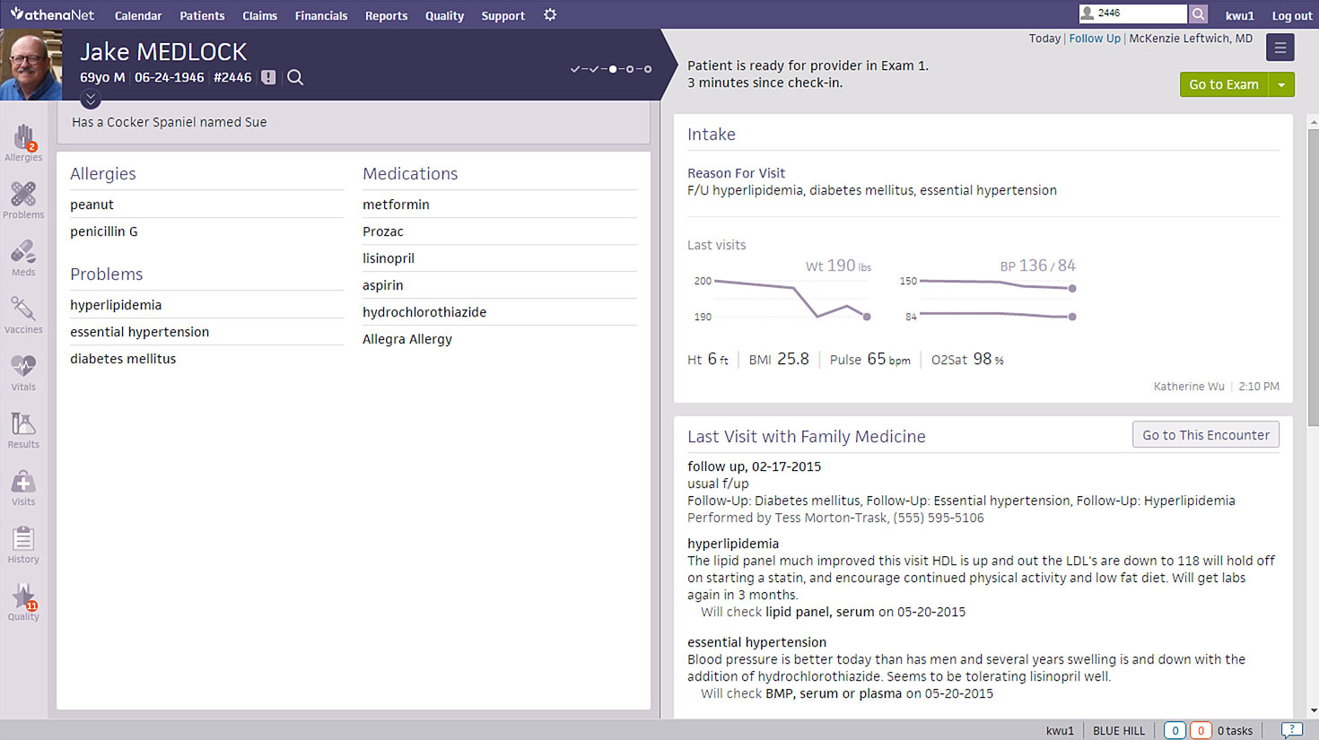
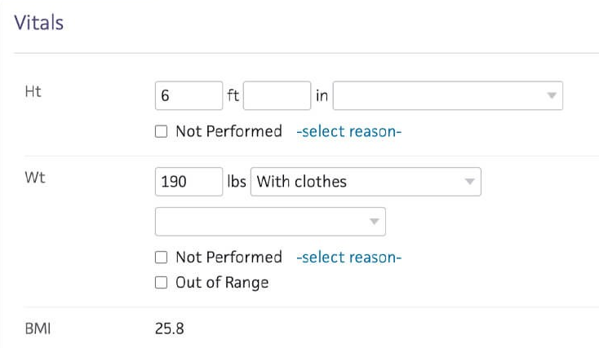
[02] Phenotyping
Phenotyping
Because these data were not collected for research purposes, they may not explicitly capture the clinical data elements we are interested in.
It is necessary to develop logic that uses what is captured in the data to infer what we are actually interested in.
We need to create a COHORT (phenotype) using a definition of how a clinical event manifests.
REAL WORLD DATA (RWD)

Slide 24
[01.1]
Cohort Building Introduction

Slide 25
[02] Phenotyping
Cohorts
A cohort is defined as a group of people who meet one or more inclusion criteria during a given period of time.
Cohorts are used across all OHDSI analytical tools and network studies as the fundamental building blocks for answering a research question.
REAL WORLD DATA (RWD)

Slide 26
[02] Phenotyping
Cohorts
Cohorts are built using independent building blocks:
“Risk of heart attack in people with diabetes”
Target Cohort
Result Cohort
Diabetis
Heart Attack

Slide 27
[02] Phenotyping
Cohorts
Cohorts are built using independent building blocks:
“Risk of heart attack in people with diabetes”
Target Cohort
Result Cohort
Diabetis
Heart Attack

Slide 28
[02] Phenotyping
Cohorts
Cohorts are built using independent building blocks:
This approach enables the reuse of cohorts for other studies.
Target Cohort
Result Cohort
Diabetis
Glaucoma

Slide 29
[02] Phenotyping
Cohorts
A cohort is analogous to a set of specific clinical codes (ICD-9/ICD-10, SNOMED, etc.).

Slide 30
[02] Phenotyping
Cohorts
A cohort is analogous to a set of specific clinical codes (ICD-9/ICD-10, SNOMED, etc.).
To create a cohort, we need to ask ourselves the following:
Which initial event defines the cohort entry point (Index Date)?
Which inclusion criteria apply to the initial events?
What defines the cohort exit point?

Slide 31
[02] Phenotyping
Cohorts
A cohort is analogous to a set of specific clinical codes (ICD-9/ICD-10, SNOMED, etc.).
To create a cohort, we need to ask ourselves the following:
Which initial event defines the cohort entry point (Index Date)?
First diagnosis of diabetes in a person.
Which inclusion criteria apply to the initial events?
Adults over 18 with at least one year of medical history.
What defines the cohort exit point?

Slide 32
[02] Phenotyping
Cohorts
A cohort is analogous to a set of specific clinical codes (ICD-9/ICD-10, SNOMED, etc.).
Para crear una cohorte tenemos que preguntarnos lo siguiente:
¿Qué evento inicial define el momento de entrada en la cohorte (Index Date)?
Primer diagnóstico de diabetes de una persona
¿Qué criterios de inclusión se aplican a los eventos iniciales?
Mayores de 18, con un historial médico de por lo menos un año
¿Qué define el momento de salida de la cohorte?
End of the study period or censoring (change of healthcare provider).

Slide 33
[02] Phenotyping
Cohorts
Cohort structure:
cohort_definition_id | subject_id | cohort_start_date | cohort_end_date
1 | 5670 | 2018-02-20 | 2021-03-02
1 | 3224 | 2015-06-13 | 2020-06-23

Slide 34
[01.2]
Cohort Definition

Slide 35
[02] Phenotyping
Cohort definition
The concepts that will make up our cohort must be properly defined:
What does it mean to be diabetic?

Slide 36
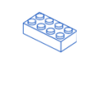
[02] Phenotyping
Cohort definition
The concepts that will make up our cohort must be properly defined:
What does it mean to be diabetic?
Having a diagnosis of diabetes mellitus.
¿Gestational diabetes? ¡No! -> Exclude
Conditions

Slide 37

[02] Phenotyping
Cohort definition
The concepts that will make up our cohort must be properly defined:
What does it mean to be diabetic?
Having a diagnosis of diabetes mellitus.
¿Gestational diabetes? ¡No! -> Exclude
Having HbA1c levels > 7.0
Conditions
Measurements

Slide 38

[02] Phenotyping
Cohort definition
The concepts that will make up our cohort must be properly defined:
What does it mean to be diabetic?
Having a diagnosis of diabetes mellitus.
¿Gestational diabetes? ¡No! -> Exclude
Having HbA1c levels > 7.0
Taking metformin during the past 3 months.
Conditions
Measurements
Drugs

Slide 39
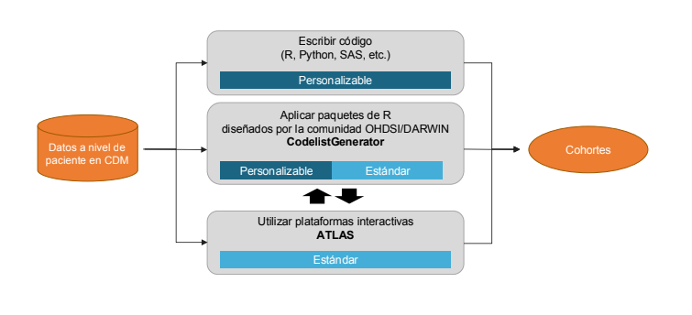
[02] Phenotyping
Cohort definition
¿Cómo se puede crear una cohorte?

Slide 40
[02] Phenotyping
Definición de cohortes
¿Cómo se puede crear una cohorte?

Slide 41
[01.3]
Cohort creation in ATLAS

Slide 42
[02] Phenotyping
Diabetis Cohort
The concepts that will make up our cohort must be properly defined:
What does it mean to be diabetic?
Having a diagnosis of diabetes mellitus.
¿Gestational diabetes? ¡No! -> Exclude
Having HbA1c levels > 7.0
Taking metformin during the past 3 months.
Conditions
Measurements
Drugs

Slide 43
[02] Phenotyping
Exercice 5: Create the “Diabetic Patient” cohort.
Cohort with the following characteristics
Having a diagnosis of diabetes mellitus.
OR
Taking metformin

Slide 44
[02] Phenotyping
Exercice 6: Create the “Diabetic Patient” cohort.
Entry Event:
Having a diagnosis of diabetes mellitus.
Inclusion criteria:
HbA1c > 9 %

Slide 45
[03]
Characterisation

Slide 46
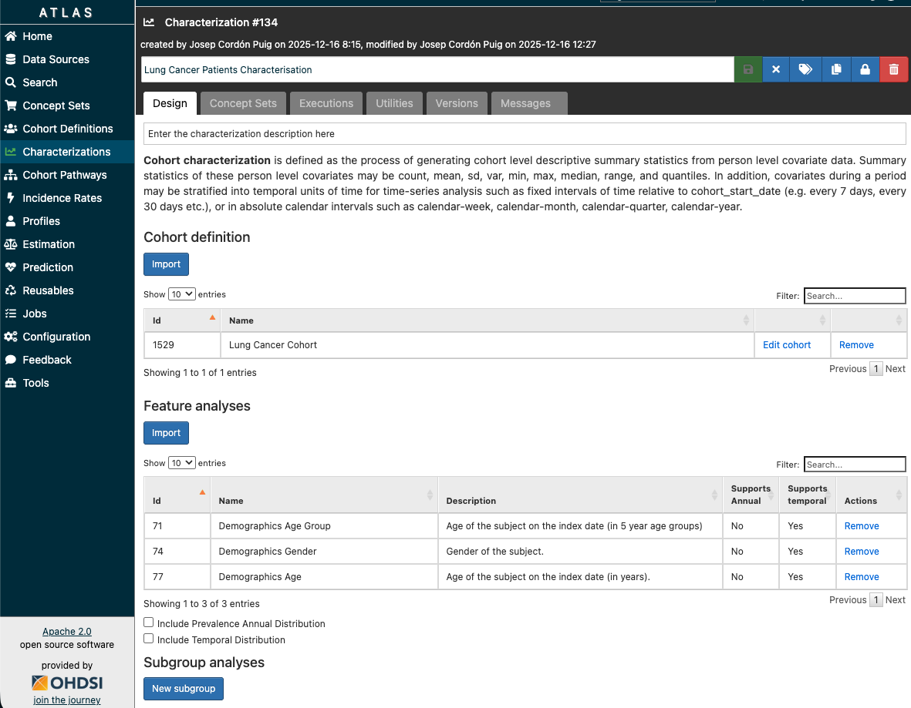
[03] Characterisation
Characterisation configuration

Slide 47
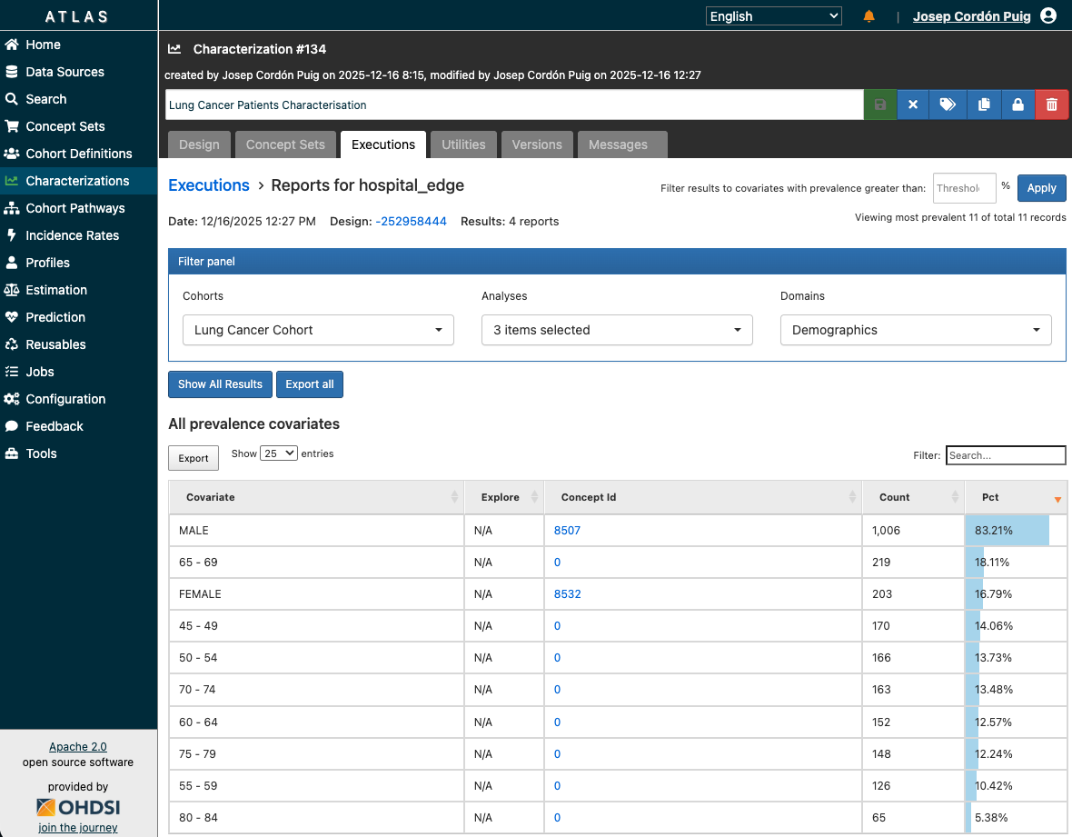
[03] Characterisation
Characterisation generation

Slide 48
[04]
Pathways

Slide 49
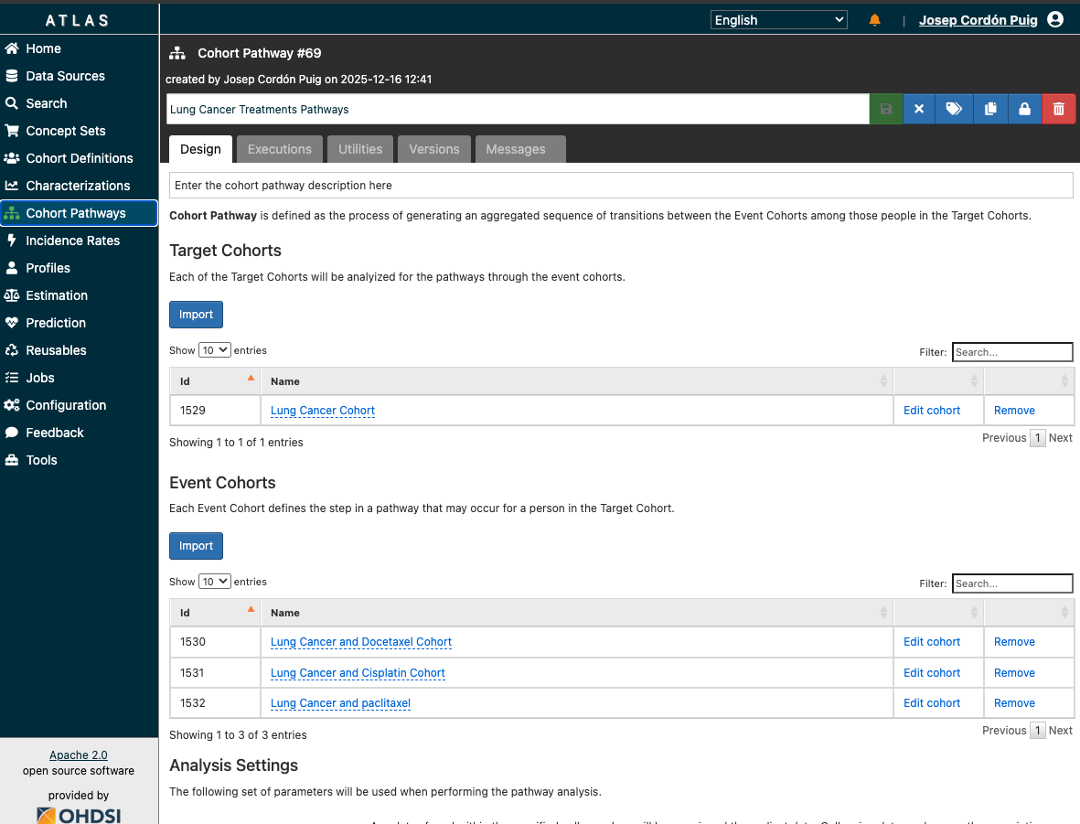
[04] Pathways
Configuración de pathways

Slide 50
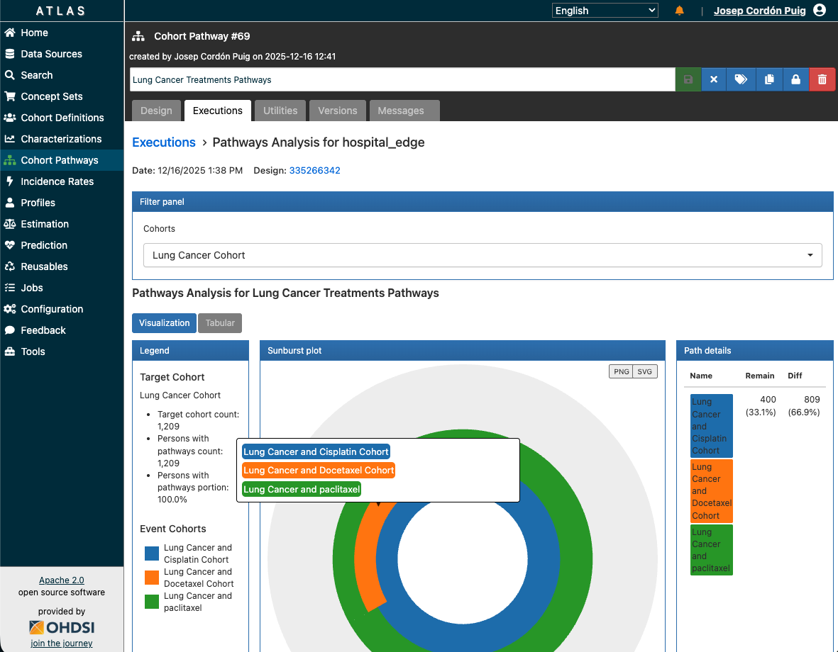
[04] Pathways
Generación de pathways

Slide 51
[05]
Incidence rates

Slide 52
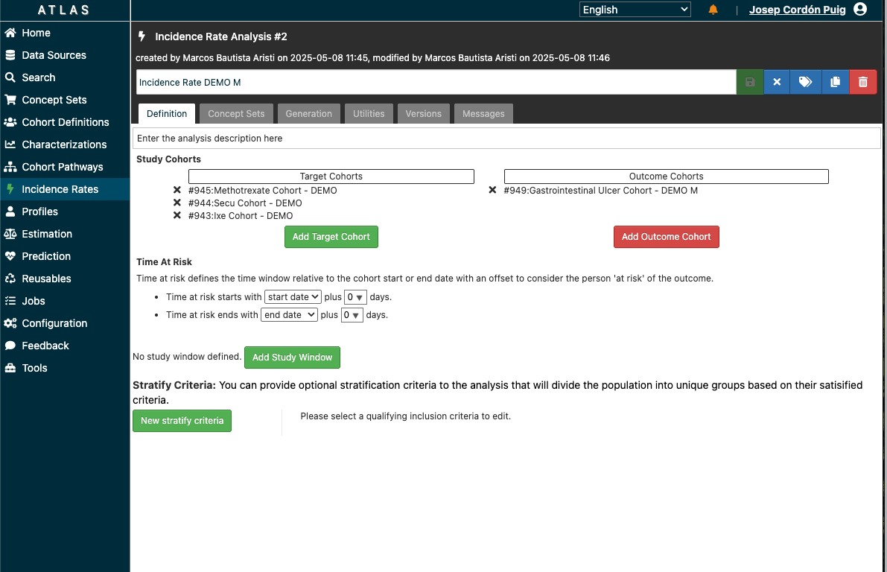
[05] Incidence Rates
Configuración de Incidence Rates

Slide 53
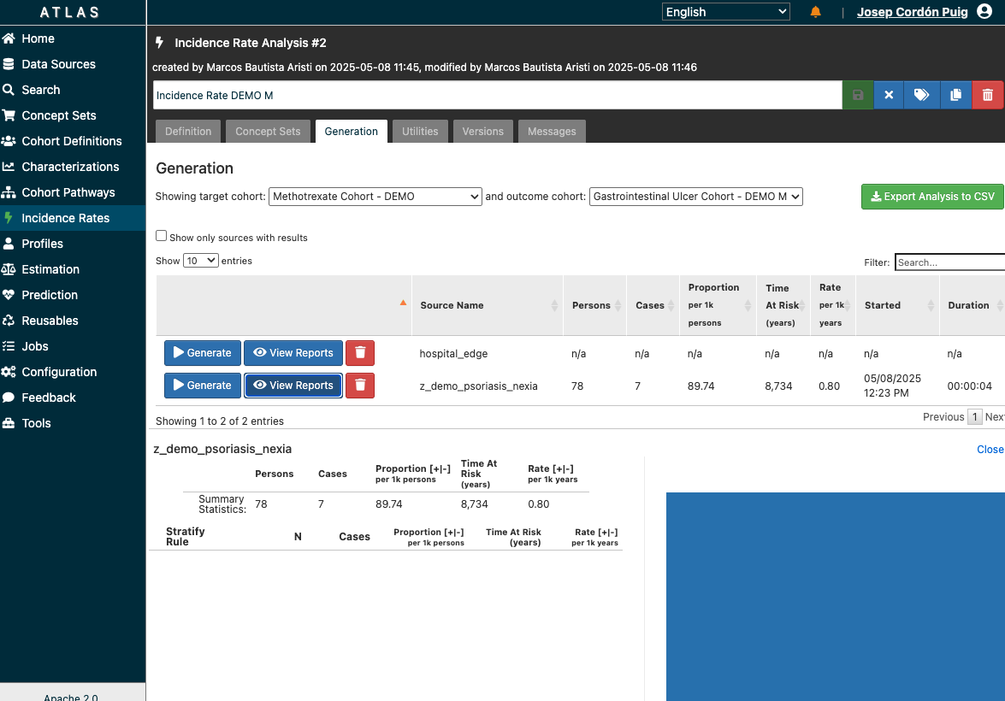
[05] Incidence Rates
Generación de Incidence Rates

Slide 54
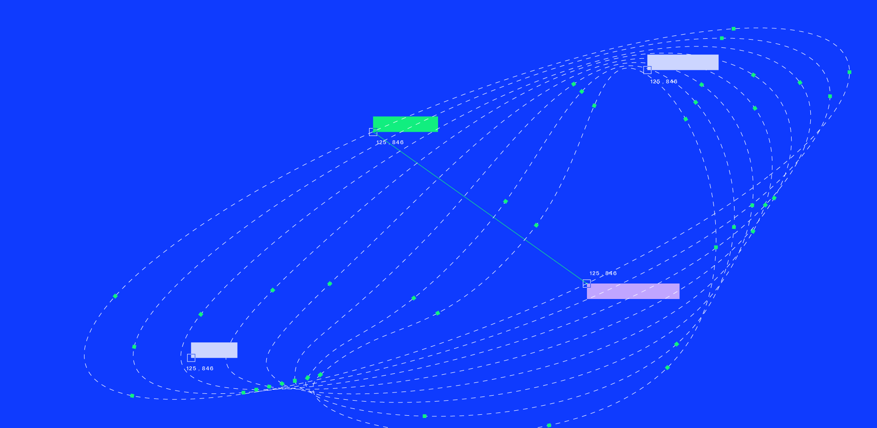


C/ de St. Antoni Maria Claret, 167, Sant Leopold Pavillion, 08025 — Barcelona
info@iomed.health
IOMED.HEALTH

